Slide 1





COST OPTIMIZATION IN PI CROSS-DOCK NETWORKS USING GENETIC ALGORITHMS
Master 2 Réseaux et système autonomes, paris cité
Presented by Zineb Taieb
Supervisors:
M Hassine Moungla
Mme Essghaier Fatma
M Allaoui Hamid
Experimental results

Slide 2
PLAN
01
02
Motivation and context
Genetic Algorithm (GA)
03
04
05
Conclusions and discussion
Genetic operators
Experimental study

Slide 3

Motivation and context

Slide 4
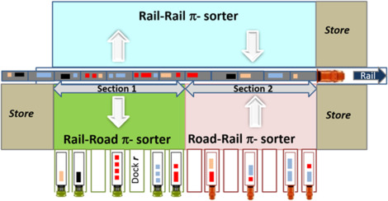
Motivation and context
Genetic operators
Objective
Related work
Conclusion and discussion
Genetic Algorithms (GA)
Experimental study
Why GA ?
WHY GA FOR CROSS DOCK OPTIMIZATION?
Objectif
We aim to optimize container-truck assignments to minimize transport cost and energy cost
NP-hard
Optimization of this kind of problems is NP-hard
Why Genetic algorithms?
Robustness, Adaptability, Flexibility(hybridization)
Physical Internet cross dock sorter [1]

Slide 5




Motivation and context
Genetic operators
Objective
Related work
Conclusion and discussion
Genetic Algorithm (GA)
Experimental study
Why GA ?
Research question
Optimizing :
And/or
While :
Completion Time
Cost
Real world constraints
NP-hard problem
Finding the optimal solution in a reasonable time is very difficult.
Find a near optimal solution with approximative methods
Explore the search space to find the global optimal solution

Slide 6
Motivation and context
Genetic operators
Objective
Related work
Conclusion and discussion
Genetic Algorithm (GA)
Experimental study
Why GA ?
Research question
Approximative Methods
Problem specific (heuristics)
Meta-heuristics
Nature inspired meta-heuristics
Non-Nature inspired meta-heuristics
Evolutionary based algo
Tabu searchalgo
Swarm Intelligence based algo
Local search
Physical/chemical based algo
Large neighbourhood

Slide 7

Motivation and context
Genetic operators
Objective
Related work
Conclusion and discussion
Genetic Algorithm (GA)
Experimental study
Why GA ?
Research question
Not Prolem specific
Scalability
Hybridization
Flexibility and adaptability

Slide 8

Motivation and context
Genetic operators
Objective
Related work
Conclusion and discussion
Genetic Algorithm (GA)
Experimental study
Why GA ?
Article Name | Objective Function | Method
Chargui, et al. (2019) Truck Scheduling in a Rail–Road PI cross-dock Considering Energy Consumption | Min energy consumption + vehicle costs | Hybrid metaheuristic (Variable Neighborhood Search+ TS(SA))
Shahram, et al. (2019)Trucks scheduling in cross-docking with energy consumption consideration and trucks queuing | Min costs of holding products in a cross-dock + energy consumption of forklift in a cross-doc | Multi objective imperialist competitive algorithm (MOICA) + multi objective grey wolf optimizer (MOGWO)
Aberka, et al. (2024) Sustainable Multi-Objective Truck Scheduling in a Rail-Road Physical Internet Cross-Docking Hub with Internal Storage | Min storage cost and energy consuption | Multi-objective Mixed Integer Programming Model (MO MIP) SEPLEX (exact method)
Madani-Isfahani, et al. (2014), Multiple cross-docks scheduling using two meta-heuristic algorithms | Min operation time | Simulated Annealing(SA) + Firefly Algorithm
Yu, et al. (2021), Hybrid GA Truck Scheduling and Product Routing on the Cross-Docking System | Min completion time | Hybrid GA
Mohtashami.A (2015) Scheduling Trucks in Cross Docking Systems with Temporary Storage and Repetitive Pattern for Shipping Trucks | Min completion | Genetic Algorithm
Maxim A. Dulebenets (2018), A Diploid Evolutionary Algorithm for Sustainable Truck Scheduling at a Cross-Docking Facility | Min total cost | Evolutionary Algorithm

Slide 9
Genetic Algorithm

Slide 10
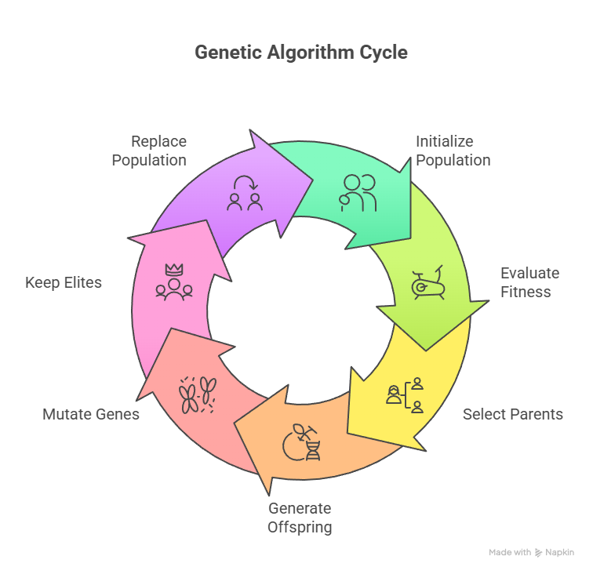
Motivation and context)
Genetic operators
Genetic algorithm cycle
Conclusion and discussion
Genetic Algorithm (GA)
Experimental study
Chromosome design

Slide 11
Motivation and context)
Genetic operators
Genetic algorithm cycle
Conclusion and discussion
Genetic Algorithm (GA)
Experimental study
Chromosome design
CHROMOSOME DESIGN
A chromosome represents a solution, each block represents a truck and its assignments.
[ 4 ] | 0 | 14 | 0 | [ ] | 0 | 2 | 0 | [ 1,2] | 0 | 4 | 0 | [] | 0 | 10 | 0
Truck id : 1
Dock Position: 14
Container : 4
Truck id : 2
Dock Position: 2
Container : none
Truck id : 3
Dock Position : 4
Container : 1 and 2
Truck id : 4
Dock Position : 10
Container : none
Truck id : Number to identify a truck
Dock position : Position of the truck in the Road part of the cross dock hub
Container : the container id assigned to the truck

Slide 12
Mathematical formulation

Slide 13

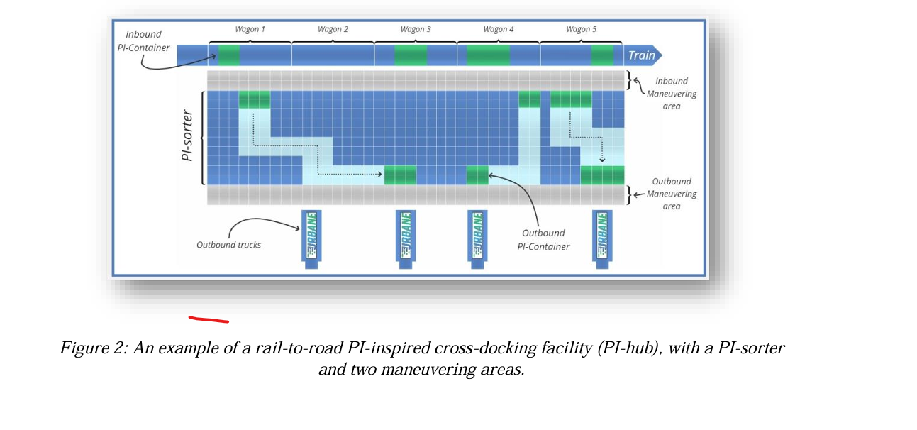
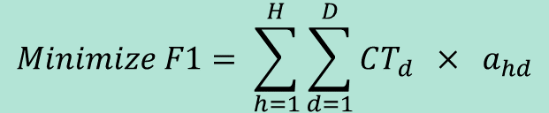
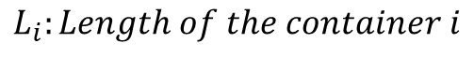
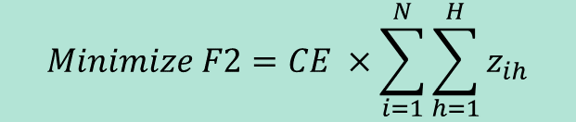
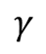
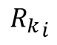
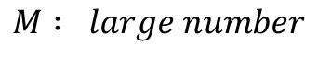
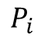
Motivation and context
Mathematical formula
Conclusion and discussion
Objective Function
Constraints
Genetic Algorithm (GA)
Experimental study
Genetic operators
Fitness Function
Objective
$$Minimize F1= \sum_{h=1}^{H}{\sum_{d=1}^{D}{CT_{d} × a_{hd}}}$$
$$Minimize F2=CE ×\sum_{i=1}^{N}{\sum_{h=1}^{H}{z_{ih}}}$$
And
[1]
$F1 :The cost of using trucks H for destinations D$
$F2 :Energy cost to assign container i to truck h$
$$P_{i}$$
Parameters :
$$CT_{d} :the cost of using truck h for destination d$$
$$CE : the cost of one energy unit to transport container i to truck h$$
$$γ$$
$$P_{i} :the container^{′}s i position in the rail area$$
$${R_{k}}_{i}$$
$$R_{k} : the truck^{′}s h position in the road area$$
$$γ : vertical length of the cross dock system$$
$$L_{i}:Length of the container i$$
Physical Internet cross dock sorter [1]
$$M : large number$$
$$z_{ih}=2\left|P_{i}−R_{k}\right|+ γ×L_{i}−M\left(2−\left(p_{ih}+x_{hk}\right)\right) ∀ i, k, h$$
Decision variables :
$z_{ih} : the area swept by the container i to reach the truck h at the k position$
$$in the cross dock$$
$$a_{hd} :binary variable , 1 if truck h is assigned to destination d, 0 otherwise$$
$$P_{ih}:binary bariable , 1 if container i is assigned to truck h$$
$$if container i is assigned to truck h and truck h is assigned to dock k in the road side,$$
$$x_{hk} :binary variable , 1 if truck h is assigned to dock k$$

Slide 14
Motivation and context
Mathematical formula
Conclusion and discussion
Objective Function
Constraints
Genetic Algorithm (GA)
Experimental study
Genetic operators
Fitness Function
Key step in the Genetic Algorithm loop
Inspired by natural selection process in Evolutionary therory
Evaluation tool

Slide 15
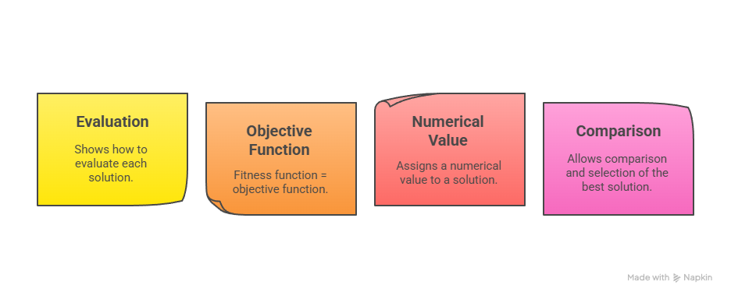
Motivation and context
Mathematical formula
Conclusion and discussion
Objective Function
Constraints
Genetic Algorithm (GA)
Experimental study
Genetic operators
Fitness Function

Slide 16

Motivation and context
Mathematical formula
Conclusion and discussion
Objective Function
Constraints
Genetic Algorithm (GA)
Experimental study
Genetic operators
Fitness Function
How can we evaluate the fitness of individuals based on two different objectives?
One optimal solution for an objective does not necessarily represent an optimal solution for the second objective.
How can a multi-objective optimization problem (with more than two objectives) be effectively transformed into a single-objective formulation that remains representative of all objectives and suitable for evaluation by a genetic algorithm?

Slide 17

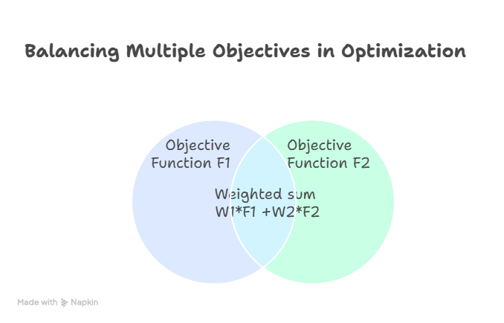

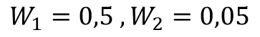
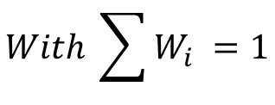
Motivation and context
Mathematical formula
Conclusion and discussion
Objective Function
Constraints
Genetic Algorithm (GA)
Experimental study
Genetic operators
Fitness Function
Approach: Weighted-Sum Fitness Function
$$Fitness=W_{1} ×F_{1}+W_{2}×F_{2}+ …+W_{n} ×F_{n}$$
$$With \sum{W_{i} =1}$$
$$Fitness=W_{1} ×{F_{1}}_{Truck cost}+W_{2} ×{F_{2}}_{Energy cost}$$
$$W_{1}=0,5 , W_{2}=0,05$$
Simplicity
Equal weights = equal influance of F1 and F2 on the total cost

Slide 18
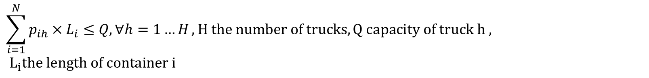
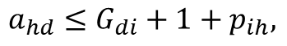
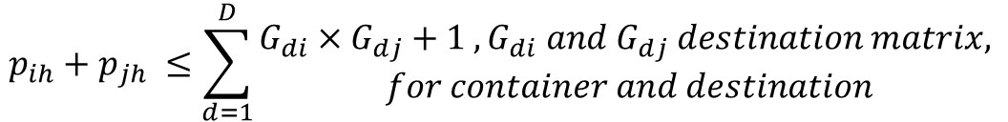
Motivation and context
Mathematical formula
Conclusion and discussion
Objective Function
Constraints
Genetic Algorithm (GA)
Experimental study
Genetic operators
Fitness Function
Container Assignment
Each container has only one destination
$$\sum_{h=1}^{H}{p_{ih}=1 , ∀ i=1…N , N the number of containers}$$
Containers assigned to truck can not exceed trucks capacity
$$\sum_{i=1}^{N}{p_{ih}×L_{i}≤Q, ∀h=1…H}, H the number of trucks, Q capacity of truck h , \\ L_{i}the length of container i$$
Truck capacity
All containers in one trucks must have the same destination
$$p_{ih}+p_{jh} ≤\sum_{d=1}^{D}{\begin{aligned}G_{di}×G_{dj}+1 , G_{di} and G_{dj} destination matrix, \\ for container and destination\end{aligned}}$$
Constraints in cross docking operations
Destination consistency
Truck has only one destination and can only load containers with the same destination
$$v_{h}=\sum_{d=1}^{D}{\begin{aligned}a_{hd} , a_{hd} : binary variable , 1 if truck h is assigned to destination d \\ v_{h} :binary variable , 1 if truck h is used\end{aligned}}$$
$$a_{hd}≤G_{di}+1+p_{ih},$$
A truck is used if it has at least one container is assigned to it
Truck usage
$$p_{ih}≤v_{h}, v_{h} is binary variable, 1 if truck h is used 0 otherwise$$
Dock Assignment
A truck can not be at two different docks at the same time
$$\sum_{k=1}^{K}{x_{hd}=v_{h} , { ∀ k=1 …K , x}_{hd} :binary variable , 1 if truck h is assigned to dock k ,}$$

Slide 19
Genetic operations
Implementation

Slide 20
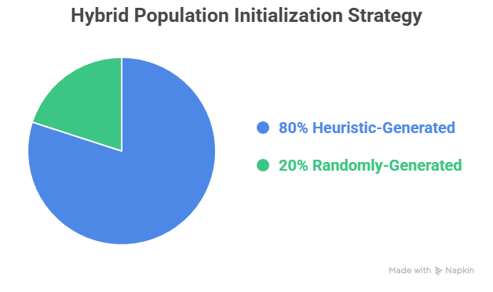

Motivation and context
Mathematical formula
Conclusion and discussion
GA operators
Handling Unfeasibility
Genetic Algorithm (GA)
Genetic operators
Experimental study
Unfeasibility
Population initialization
Parent selection
Crossover
Mutation
New generation
Heuristic population initialization : Binpacking
Group containers by destination and sort by decreasing length
For each destination group:
If truck is new , assign destination to truck
Else assign container to truck with same destination and enough capacity
Move to next container
Mixed initialization :
Best fit decreasing, fil the trucks to max, no truck waste
Fast and less computational time

Slide 21
Motivation and context
Mathematical formula
Conclusion and discussion
GA operators
Handling Unfeasibility
Genetic Algorithm (GA)
Genetic operators
Experimental study
Unfeasibility
Population initialization
Parent selection
Crossover
Mutation
New generation
Population
Population
Tournament selection
Select random 3 individuals
Select random 3 individuals
Select a group of k individuals from population
For each individual :
Calculate fitness
Best_individual = best_fitness
Fitness Evaluation
Fitness Evaluation
Return Best_individual.copy()
Select best Individual
Select best Individual
Parent 1 = Best individual .copy()
Parent 2 = Best individual .copy()

Slide 22
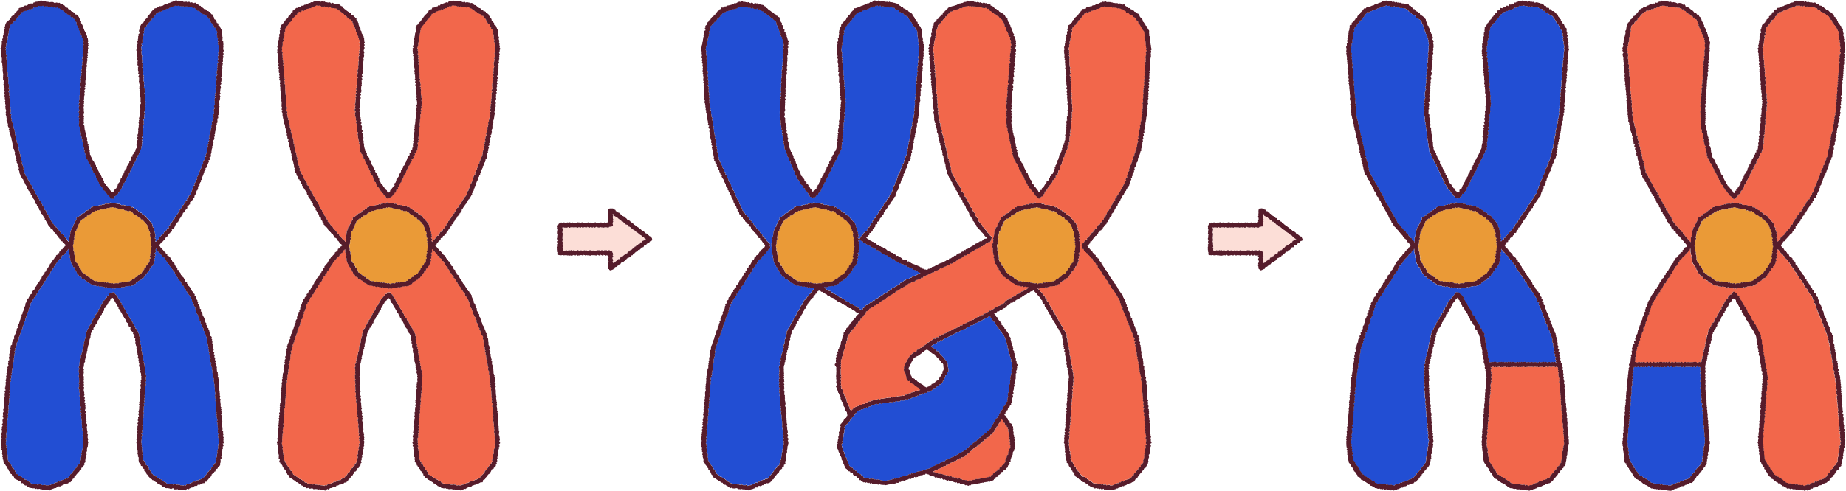

Motivation and context
Mathematical formula
Conclusion and discussion
GA operators
Handling Unfeasibility
Genetic Algorithm (GA)
Genetic operators
Experimental study
Unfeasibility
Population initialization
Parent selection
Crossover
Mutation
New generation
Parent 2 : [ [3,7],0,4 ,0,{Crossover point} [],0,7 ,0,[2],0, 6, 0 ]
Offspring 1 : [ [4,6],0,3,0, [],0,7 ,0,[2],0, 6, 0 ]
Parent 1 : [ [4,6],0,3,0, {Crossover point}[1],0, 5 ,0,[],0, 1 ,0 ]
Offspring 2 : [ [3,7],0,4 ,0, [1],0, 5 ,0,[],0, 1 ,0 ]
One point Crossover
Generate random float number [0, 1[:
If random number< mutation rate:
One point cross over (Parent 1, Parent 2)
Else :
Offspring 1, Offspring 2 = copy(Parent 1, Parent 2)
Mutation rate : Probability for parents to crossover
One point crossover : Preserves the chromosome structure

Slide 23

Motivation and context
Mathematical formula
Conclusion and discussion
GA operators
Handling Unfeasibility
Genetic Algorithm (GA)
Genetic operators
Experimental study
Unfeasibility
Population initialization
Parent selection
Crossover
Mutation
New generation
Chromosome : [ [4,6],0,3,0,[],0,7 ,0,[2],0, 6, 0 ]
< Mutation rate
Yes
No
Swap containers
Chromosome: [ [2],0,5,0,[],0,3 ,0,[4,6],0, 1, 0 ]
Mutate dock position
Chromosome : [ [4,6],0,5,0,[],0,3 ,0,[2],0, 1, 0 ]
Container swap
Dock mutation
Generate random float number [0, 1[:
If random number < Mutation rate:
Chose two random indexes ; indx1, indx2
Swap containers in index1 and index2
Return chromosome
Generate random float number [0, 1[:
If random number > Mutation rate:
replace all docks of chromosome with random generated docks
Return chromosome
Mutation rate : Probability for parents to Mutate
Dock mutation: Changes dock numbers of chromosome
Swap containers: Exchange containers between trucks

Slide 24
Motivation and context
Genetic operators
Why GA ?
Conclusion and discussion
Genetic Algorithms (GA)
Experimental study
Related work
Crossover
GENETIC OPERATIONS
Flip a coin :
if random.random()< crossover_rate=0.9
Uniforme crossover
Parent 1 : [ [4,6],0,3,0, {Point de croisement}[1],0, 5 ,0,[],0, 1 ,0 ]
Enfant 1 : [ [4,6],0,3,0, [],0,7 ,0,[2],0, 6, 0 ]
Parent 2 : [ [3,7],0,4 ,0,{Point de croisement} [],0,7 ,0,[2],0, 6, 0 ]
Enfant 2 : [ [3,7],0,4 ,0, [1],0, 5 ,0,[],0, 1 ,0 ]
Else:
Enfant 1 =parent 1
Enfant 2 =parent 2
Mutation
Mutate dock position
Chromosome : [ [4,6],0,5,0,[],0,3 ,0,[2],0, 1, 0 ]
Chromosome : [ [4,6],0,3,0,[],0,7 ,0,[2],0, 6, 0 ]
Flip a coin :
if random.random()< mutation_rate=0.03:
Swap containers
Chromosome: [ [2],0,5,0,[],0,3 ,0,[4,6],0, 1, 0 ]

Slide 25

Motivation and context
Mathematical formula
Conclusion and discussion
Objective Function
Constraints
Genetic Algorithm (GA)
Genetic operators
Experimental study
Fitness Function
IMPLEMENTATIONS DETAILS
Generate_initial-population.py
Generate_random_population()
Ran_ga.py
Generate_controled_population()
Utils.py
verify_solution_feasibility
for individu in population :
Return population(random_population+controlled_population)
Calculate_fitnes (individu)
Select_parents
Select elits
Crossover(parents)
Population
Mutate children
Replace parents with children
Return best individu = best_fitness
New genration
main.py
For instance in instances:
Run_ga(instance)
verify_solution_feasibility()
repair_chrom()
save results

Slide 26


Motivation and context
Mathematical formula
Conclusion and discussion
Why GA ?
Handling Unfeasibility
GA operators
Genetic operators
Related work
Genetic Algorithm (GA)
Experimental study
Unfeasibility
Mutation & Crossover can generate unfeasible solutions
Example
Truck id | Destination | Capacity
1 | 1 | 13
2 | 2 | 13
3 | 1 | 13
4 | 2 | 13
Chromosome | Violation of the constraints
 | Multiple destination in truck 1 Container duplicated: 1,2 Truck 1 :[3,2,1] → destination : 1, container 2 →destination :2 →destination mismatch
 | Empty trucks
 | Truck 1 capacity exceeded, length(4,2,3,1,5) = 15> truck’s capacity(13)
[ [3,2,1],0,3,0, [4,2],0, 5 ,0,[],0, 1 ,0 ,[1,2],0,10,0,[],0,1,0 ]
[ [],0,14,0, [],0, 2 ,0,[],0, 1 ,0 ,[],0,11,[],0,10,0 ]
Container id | Destination | Length
1 | 2 | 3
2 | 2 | 5
3 | 1 | 2
4 | 3 | 3
5 | 4 | 4
[ [4,2,3,1,5],0,14,0, [],0, 4 ,0,[],0, 1 ,0 ,[],0,13,[],0,10,0 ]
Score very low fitness = considered “good solution” for the GA
“good solutions” survive to the next generation
Good new !
Prevent unfeasible solutions from propagating by a simple strategy

Slide 27

Motivation and context
Mathematical formula
Conclusion and discussion
GA operators
Handling Unfeasibility
Genetic Algorithm (GA)
Genetic operators
Experimental study
Unfeasibility
Strategy: repair wrong chromosomes, implemented in the correct_chrom function
[ [3,2,1],0,3,0, [4,2],0, 5 ,0,[],0, 1 ,0 ,[1,2],0,10,0,[],0,1,0 ]
Gather errors
Reassign removed containers
Removed = 2
[3,2,1]
[1,2]
[4,2]
Multiple destinations: (2,1)
Duplicated containers : 1,2
Look for available trucks with capacity, destination compatibility
Keep containers with dominant destination, remove others
Remove containers (1,2)
[3,2,1]
Truck 1 → destination 1
Truck 2 → destination 2
Removed container : 2
[1,2],
[4,2]
[ [3,1],0,3,0, [4,2],0, 5 ,0,[],0, 1 ,0 ,[],0,10,0,[],0,1,0 ]

Slide 28
Motivation and context
Mathematical formula
Experimental study
GA operators
Handling Unfeasibility
Genetic Algorithm (GA)
Genetic operators
Conclusion and discussion
Unfeasibility
Child
Reassign removed containers
Verify feasibility
Yes
Look for available trucks with capacity, destination compatibility
No
Gather errors
Reassign containers
Multiple destinations
Unassigned containers
Duplicated containers
Capacity exceeded
Valid children← Child
Remove containers
Delete
Valid children =2?
No
Removed container
Yes
New generation ← Valid children

Slide 29

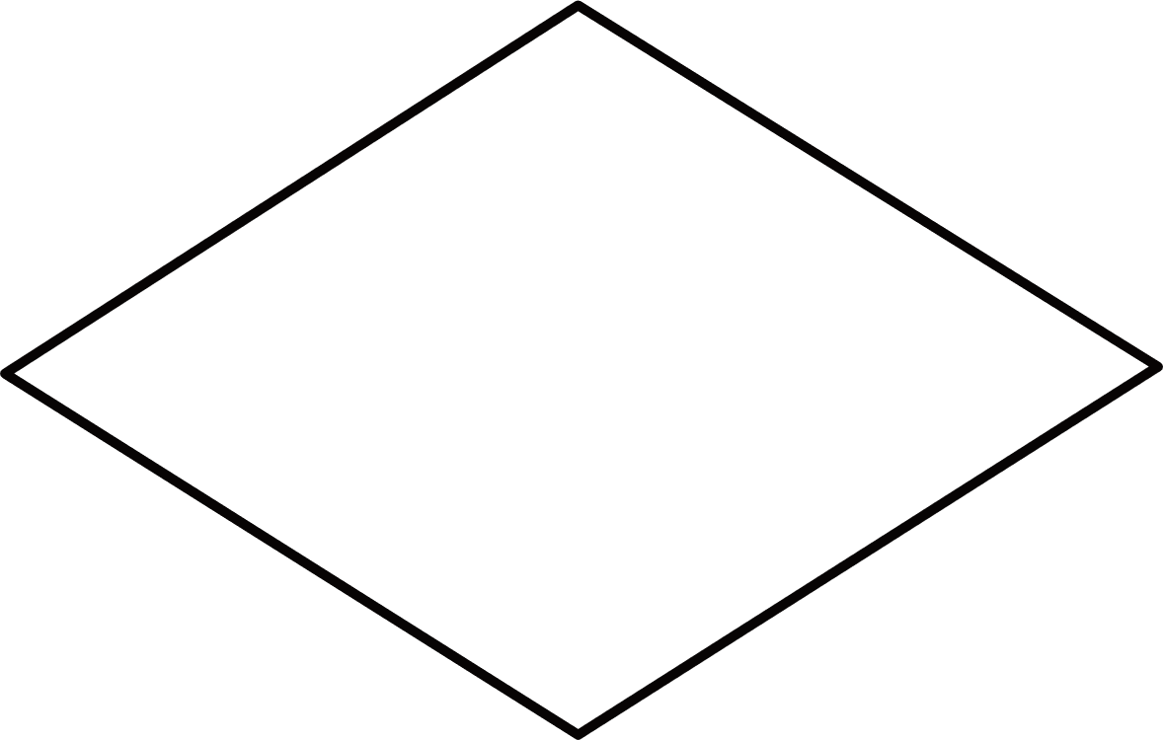

Motivation and context
Genetic operators
Why GA ?
Conclusion and discussion
Genetic Algorithms (GA)
Experimental study
Related work
child1, child2 = crossover(parent1,parent2)
verify feasibility
for i in max_attempt
child1, child2 = Mutate(child1,child2)
offspring<---valid_children
Handling constraints and unfeasible solutions
Correct_chrom(child
verify feasibility
valid_children >=2 ?
: verify_feasibility and correct chromosome process
: Genetic operations, creating children and mutatin them
: repeat the verification and correction 2X
Correct_chrom(child)
: add valid children to the new generation
new_generation<---offspring
valid_children<---child

Slide 30
Experimental Study

Slide 31



Motivation and context
Genetic operators
Why GA ?
Conclusion and discussion
Genetic Algorithms (GA)
Experimental study
Related work
Objective:
Compare the performance of different approaches on the same dataset using benchmark_set_for_sustainability_2019 by Chargui
Implementation method :
Tests & comparison
GA (Controlled + Random Population): mix of random and guided initialization.
Exact Method: used as a benchmark for optimal results.
Evaluation method :
All methods executed on the same set of instances
Measured cost per instance to evaluate performance.
Results presented in plots comparing cost for three methods

Slide 32

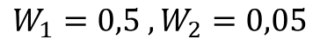
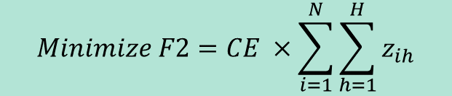
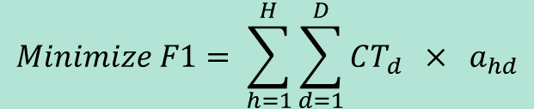
Motivation and context
Mathematical formula
Experimental study
Genetic Algorithm (GA)
Genetic operators
Conclusion and discussion
Exact method code structure
//Set Parameters
N_list # list of containers
H_list # list of trucks
K_list # list of docks
D_list # destinations
# Données de base
W1, W2 = 0.5, 0.5
Y = 12 # length of cross dock system
# initialize model
m = Model(f"Instance_{instance_id}_Transport_Energie« )
# Time limit: 2 hours
m.setParam("TimeLimit", 7200)
//Add decision variables
a : binary d is destination of the truck h
X : binary truck h is assigned to dock k
P : binary container n is assigned to truck h
v_used : binary truck is used ,
n : binary same dock for two trucks
Z : continous area swept by the container
//Add constraints
m.addConstrs
.
.
//Solve
m.optimize()
//Save results in csv
df_results = pd.DataFrame(results)
df_results.to_csv("results_exact_summary_with_chargui_instances_time_limit_2_h.csv", index=False)
Gurobipy: A gurobi python interface, version : python3.12-gurobi
Gurobi is a Mathematical solver , for decision making problems
Optimize :
$$Minimize F1= \sum_{h=1}^{H}{\sum_{d=1}^{D}{CT_{d} × a_{hd}}}$$
$$Minimize F2=CE ×\sum_{i=1}^{N}{\sum_{h=1}^{H}{z_{ih}}}$$
And
$F1 :The cost of using trucks H for destinations D$
$F2 :Energy cost to assign container i to truck h$
Unified Objective function: Weighted Sum, W1=0.5 W2= 0.5
$$Fitness=W_{1} ×{F_{1}}_{Truck cost}+W_{2} ×{F_{2}}_{Energy cost}$$
$$W_{1}=0,5 , W_{2}=0,05$$

Slide 33
Motivation and context
Mathematical formula
Experimental study
Benchmark
Genetic Algorithm (GA)
Genetic operators
Conclusion and discussion
Instances taken from benchmark available in the link [3] Benchmark_instances_set_for_Sustainability_2019.zip
Instance | file Name | #containers | #Destinations | Docks
4 | inst_4_3_4.txt | 4 | 1-2-3 | 15
5 | inst_5_2_4.txt | 5 | 1-2-3 | 15
6 | inst_6_3_5.txt | 6 | 1-2-3 | 15
7 | inst_7_1_5.txt | 7 | 1-2-3 | 15
8 | inst_8_1_5.txt | 8 | 1-2-3 | 15
9 | inst_9_2_7.txt | 9 | 1-2-3 | 15
10 | inst_10_1_7.txt | 10 | 1-2-3 | 15
11 | inst_11_2_7.txt | 11 | 1-2-3 | 15
12 | inst_12_3_7.txt | 12 | 1-2-3 | 15
20 | inst_20_7_15.txt | 20 | 7 | 15
20 | inst_20_10_15.txt | 20 | 10 | 15
30 | inst_30_7_20.txt | 30 | 7 | 15
30 | inst_30_10_20.txt | 30 | 10 | 15
30 | inst_30_15_20.txt | 30 | 15 | 15
32 problem instances for “multiobjective Sustainable Truck scheduling in a rail road physical internet cross docking hub” [3] where each file represents an instance problem
File Name : Inst_N_D_H,txt
N : number of containers
D : # Destinations
H : # Trucks
Each file contains information about:
K : number of docks
Q : capacity of trucks
C_e : Energy cost/1 unit
C_dt : cost of each truck for destination d
Y : vertical length of cross dock
L : length containers
P : positions of the Pi_containers
R : Positions of the trucks
G : matrix (Destination X container)
For each file we extract (N, D, H, K, Q, C_e, C_dt, L, P, R, G)

Slide 34

Motivation and context
Genetic operators
Why GA ?
Conclusion and discussion
Genetic Algorithms (GA)
Experimental study
Related work
Experimental setup
Benchmark_instances_set_for_Sustainability_2019,zip
Gurobi parameters
GA parameters (first run)
Number_generations:10
Population_size:10
Mutation_rate:0.03
Crossover_rate:0.9
Ratio_binpacking=0.8
ClusterTech3E setup :
Data : Chargui’s benchmark “Benchmark_instances_set_for_sustainability (2019)
Time limits [300 s, 600 s, 7200(2h) s]
Gurobi License : Free academic license, version 12

Slide 35

Motivation and context
Genetic operators
Why GA ?
Conclusion and discussion
Genetic Algorithms (GA)
Experimental study
Related work
Computational setup
Why Computational cluster ?
32 large instances , complicated calculations lead high computational complexity
Mixed Integer models and iterative algorithms require significant CPU time
HPE : faster, scalable and high computational power
HPE Cluster:
Name : Tech3E (LGI2A _ Université d’Artois)
Access : Slurm Worload manager, Linux
Usage : Batch execution of large experiments
Http : https://www.hpe.com/emea_europe/en/hpe-proliant-dl385-gen11.html
HPE Cluster:
CPU : 2 x AMD EPYC 9224 CPU , 24 cores , 2 threads per core
Memory : 640 Go theory, 629 Go available
http : https://www.amd.com/en/products/processors/server/epyc/4th-generation-9004-and-8004-series/amd-epyc-9224.html

Slide 36
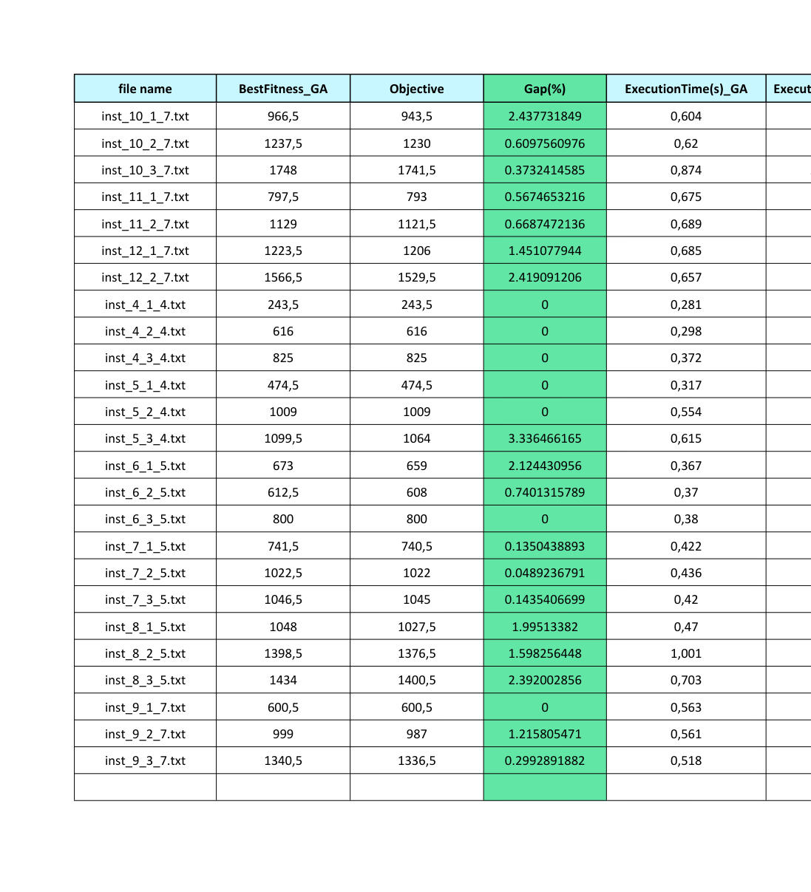
Motivation and context
Genetic operators
Why GA ?
Conclusion and discussion
Genetic Algorithms (GA)
Experimental study
Related work
Clear improvement of the results for the GA.
Main changes:
Gap =0, for 7 instances, GA scored exactly as Gurobi solver
The GA achieves high-quality solutions, very close to the optimal objective (average gap ≈ 0.5 to 2.22%).
Gurobi solver achieves the optimal solutions , but at the cost of execution time, especialy for bigger instances.
GA vs method_exact

Slide 37
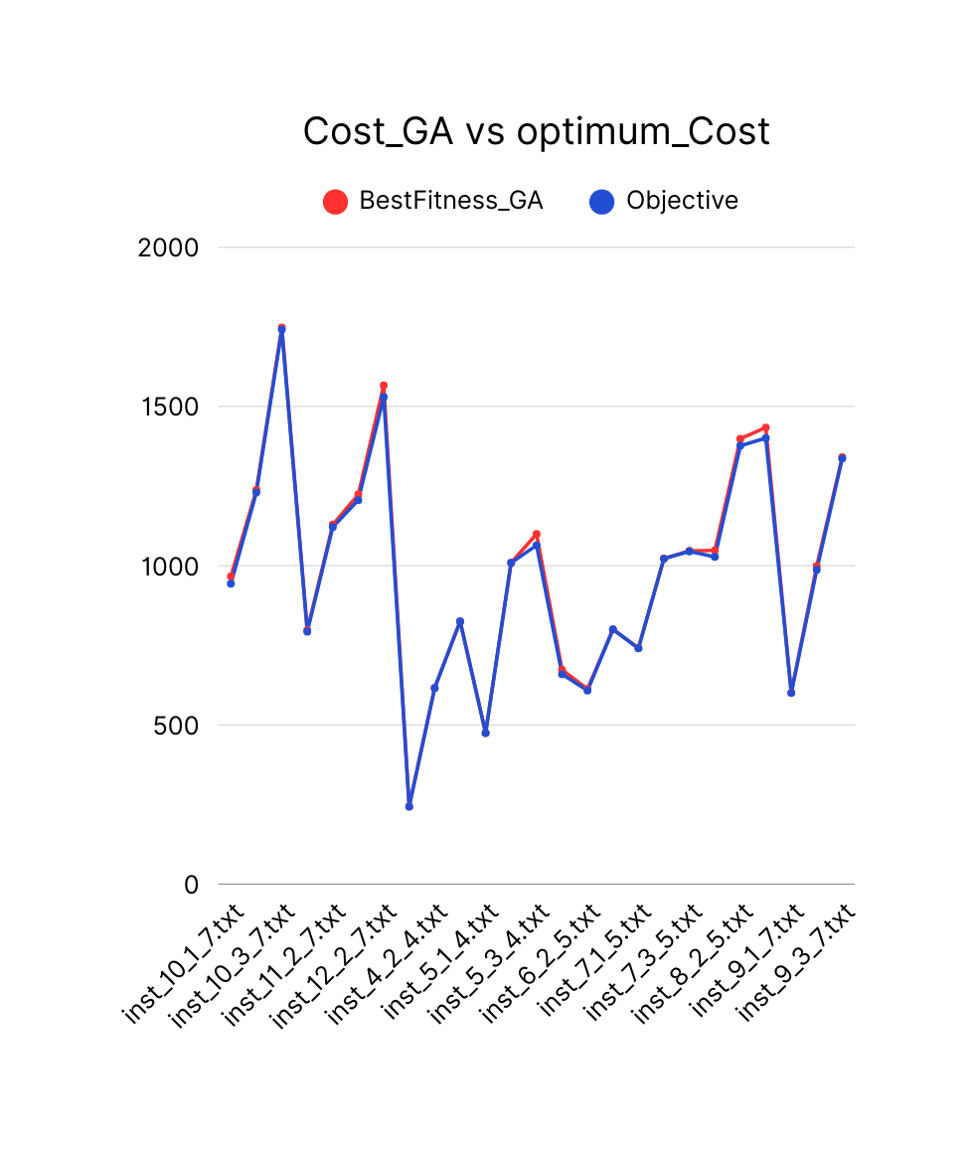
Motivation and context
Genetic operators
Why GA ?
Conclusion and discussion
Genetic Algorithms (GA)
Experimental study
Related work
Total cost comparison

Slide 38
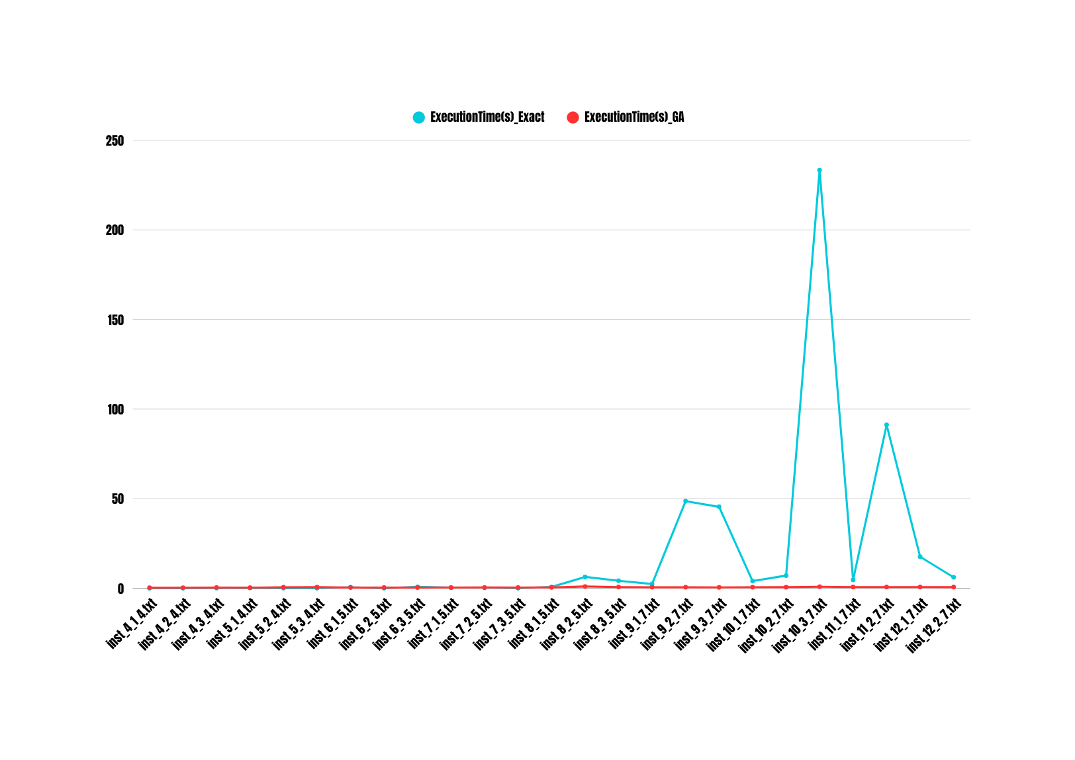
Motivation and context
Genetic operators
Why GA ?
Conclusion and discussion
Genetic Algorithms (GA)
Experimental study
Related work
Computational time

Slide 39
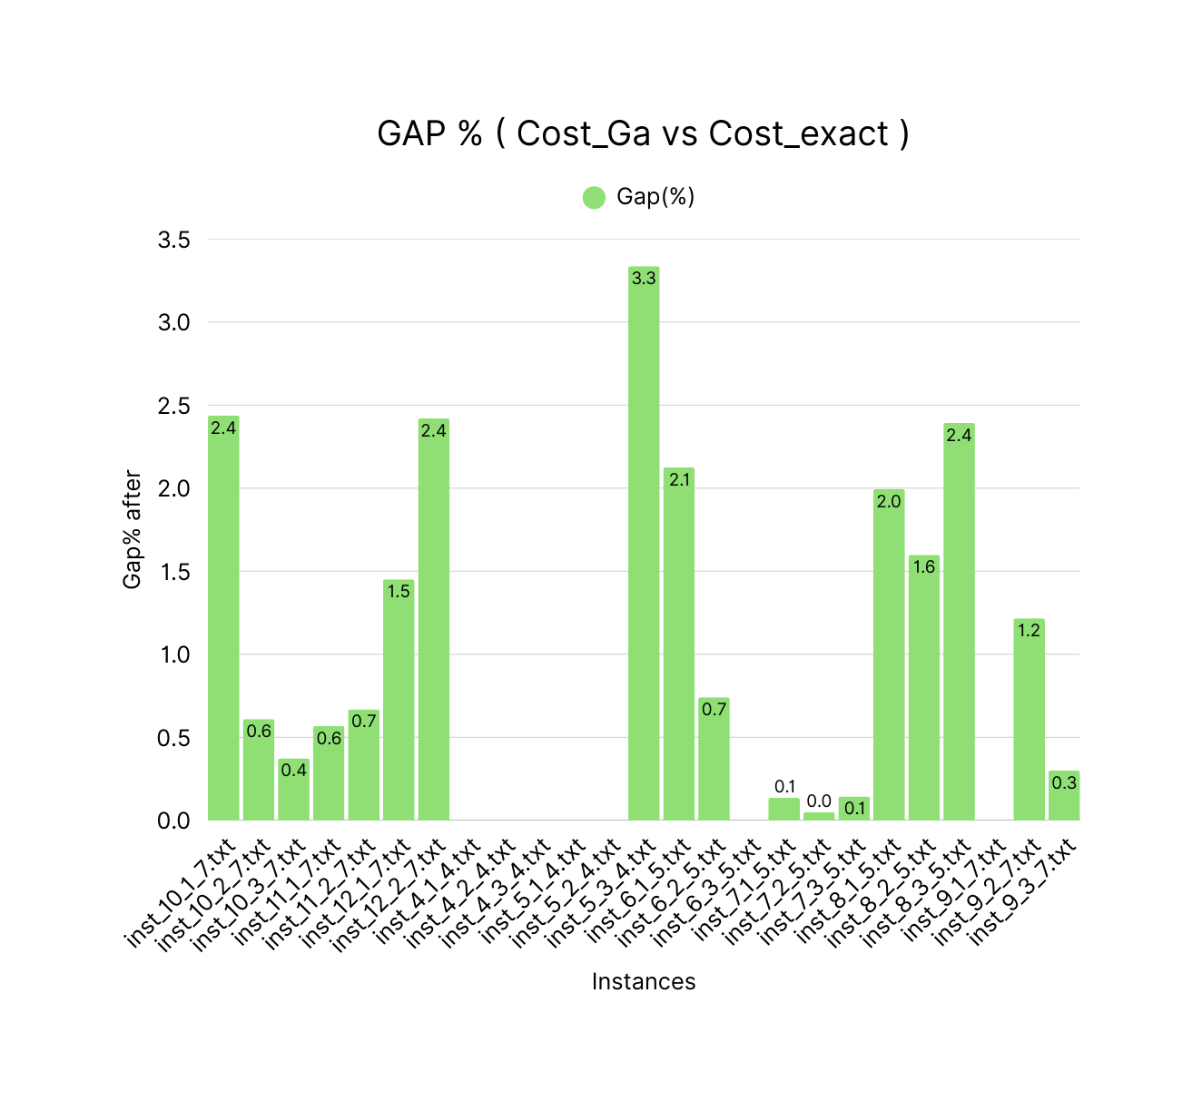
Motivation and context
Genetic operators
Why GA ?
Conclusion and discussion
Genetic Algorithms (GA)
Experimental study
Related work
GAP

Slide 40
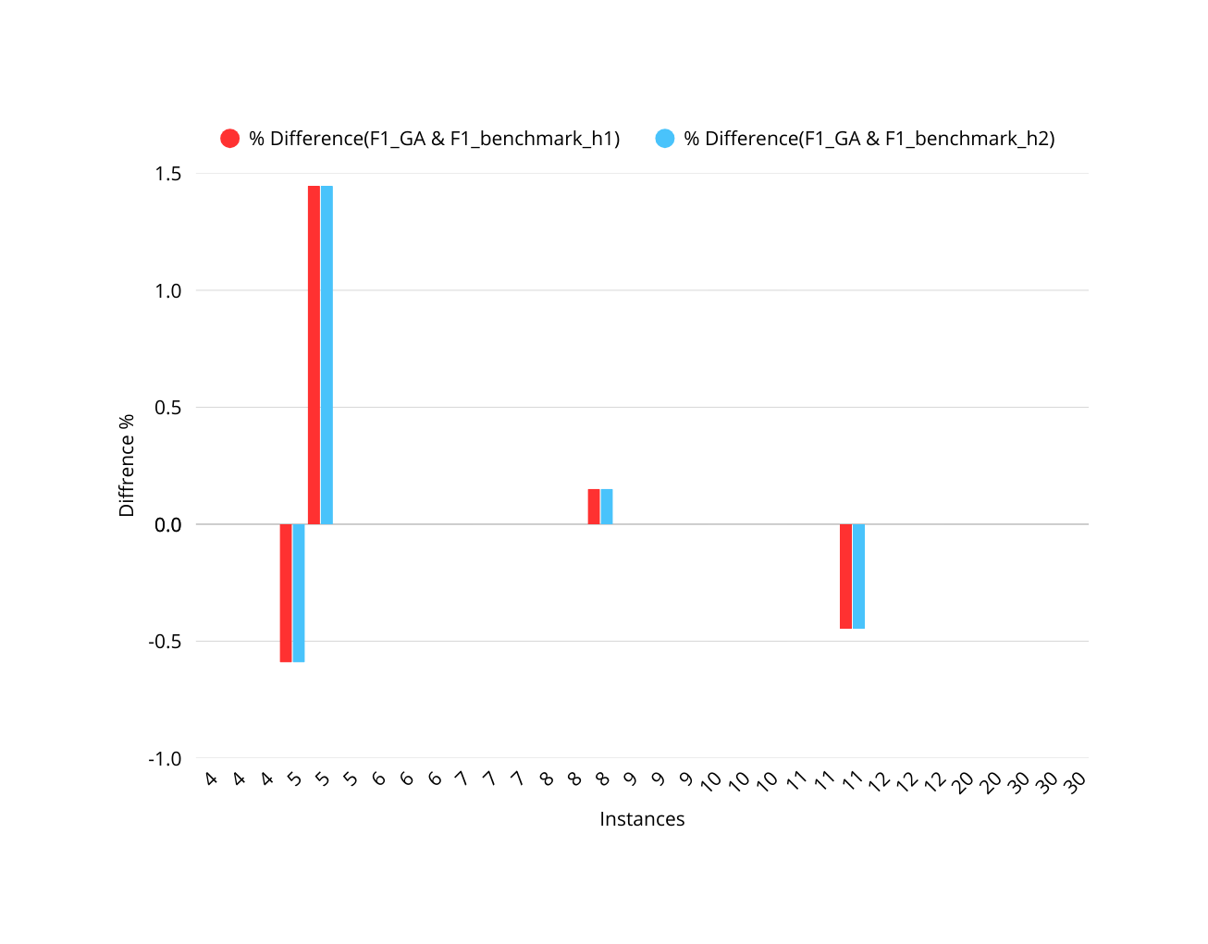
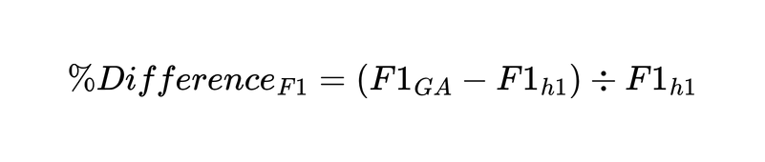
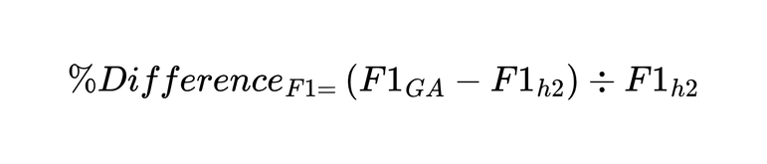
Motivation and context
Genetic operators
Why GA ?
Conclusion and discussion
Genetic Algorithms (GA)
Experimental study
Related work
Difference in truck cost calculated by GA and heuristic 1
Difference in truck cost calculated by GA and heuristic 2
Truck cost comparison
Observation
GA scored lower values of the truck cost for 2 instances
and higher values of truck cost for 2 author instances
The rest of the instances, the values are equal
Difference in truck cost F1 calculated by GA and truck cost F1 calculated by heuristics (h1) and (h2) in benchmark

Slide 41
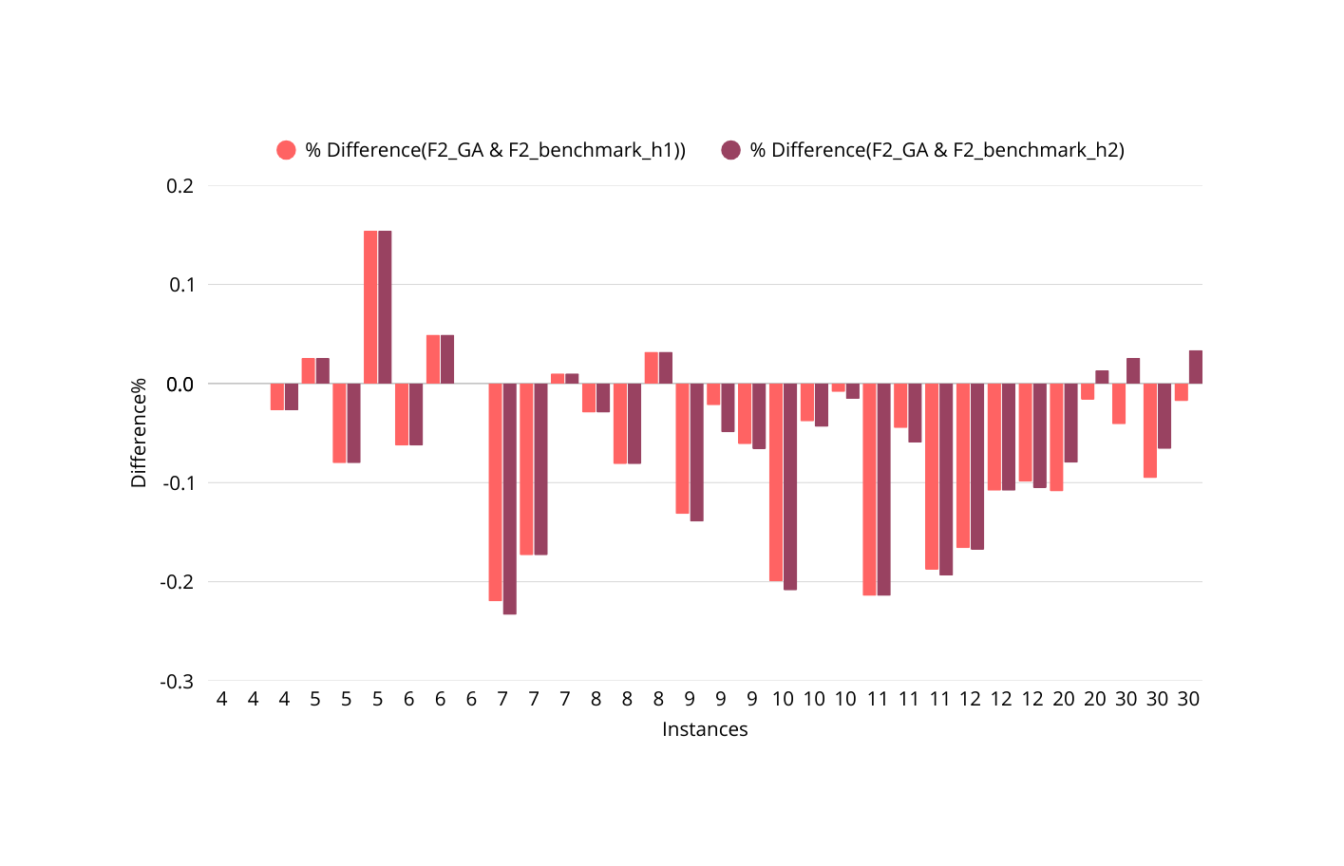
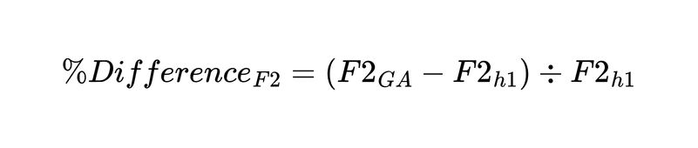
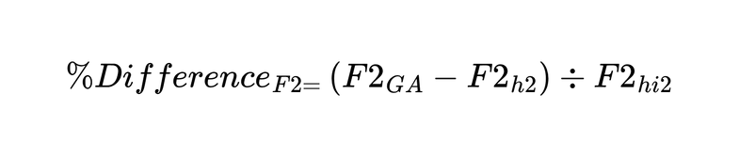
Motivation and context
Genetic operators
Why GA ?
Conclusion and discussion
Genetic Algorithms (GA)
Experimental study
Related work
Difference in energy cost calculated by GA an heuristic 1
Energy cost comparison
Difference in energy cost calculated by GA an heuristic 2
Observation
GA scored lower values of the energy cost for approximately 21 instances
Difference in energy cost F2 calculated by GA and energy cost F2 calculated by heuristics (h1) and (h2) in benchmark

Slide 42
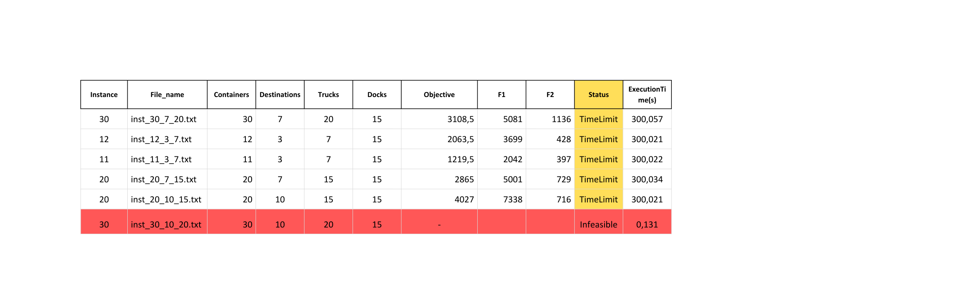
Motivation and context
Genetic operators
Why GA ?
Conclusion and discussion
Genetic Algorithms (GA)
Experimental study
Related work
GA vs method_exact_after ( Unfeasible and hard )
Total cost comparison
Unsolved instances:
Time limit = 300 s
5 instances have been stopped by time limit
1 instance was found unfeasible
Suspect cause: Instances too large for the model to solve

Slide 43
Motivation and context
Genetic operators
Why GA ?
Conclusion and discussion
Genetic Algorithms (GA)
Experimental study
Related work
#Trucks | #Containers | %hard instance | Observation | #Destinations
4 | 4-5 | 0% | All instances are solved optimally | 1-3
5 | 6-8 | 0% | All instances are solved optimally | 1-3
7 | 9-10 | 0% | All instances are solved optimally | 1-3
7 | 11-12 | 0% | Optimal solutions are obtained, but with higher computation times. | 1-2
7 | 11-12 | 33% | One out of three instances reaches the time limit. | 3
15 | 20 | 100% | All instances are difficult (systematic time limit). | 7 & 10
20 | 30 | 67% | Two out of three instances are difficult. | 7 & 15
20 | 30 | Unfeasible | Unfeasible | 10
To evaluate the difficulty of the model, we measure for every instance configuration the proportion of runs considered “hard”
“hard” is defined as :
Termination due to time limit or
MIPgap > 5%
Model’s limits
32 total benchmarck instances
25 instances found optimal solutions
6 marked “hard” instances.
1 instance marked Unfeasible

Slide 44
Conclusions and discussion

Slide 45

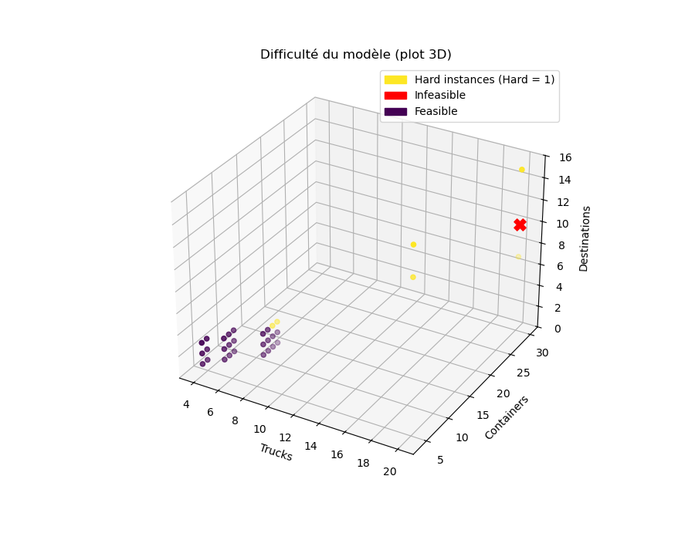


Motivation and context
Genetic operators
Why GA ?
Conclusion and discussion
Genetic Algorithms (GA)
Experimental study
Related work
Eazy region
Three distinct difficulty regions:
[4 to 7] trucks and [5 to 10] containers, the solver found optimal solutions easily
Model’s limits
Transition region
Starting from 7 trucks and 10 to 12 containers, approximately 33% of instances reach the time limit; the model is still solvable but demands more computational power.
Difficult region (large instances)
15 trucks, 20 trucks, and 7-10 destinations; all instances reached the time limit
20 trucks, 30 containers, 7-15 destinations; 67% hit time limit.
20 trucks, 30 containers, and 10 destinations; the instance is unfeasible.

Slide 46
Conclusion & key improvements & future work
Big instances->GA faster-> Lose precision
Big instances->Exact_methode found optimal-> bigger time execution
Initial initialization plays a big role on the quality of the GA solutions
Solution representation plays a big role in the effectiveness of the genetic algorithm
Tradeoff (Optimal solutions, and Running time)
The results are still being stabilized, but the observed trends indicate that GA can provide a quick alternative, especially for large instances.
Experiment with other genetic operations, fitness sharing,random immigration, other combinations of crossover, ...
Move to Multi-Objective GA (NSGA-II)(Use NSGA-II to generate a Pareto front of best compromises)
Parameter tuning: population size, crossover rate, mutation rate, elitism.
Explore hybridized metaheuristics

Slide 47
References
[1] : Tran-Dang et al , (2021)
[2] : Chargui et al , (2019)
[3] : https://www.researchgate.net/publication/348784305_Benchmark_instances_set_for_Sustainability_2019zip?_tp=eyJjb250ZXh0Ijp7ImZpcnN0UGFnZSI6ImhvbWUiLCJwYWdlIjoicHVibGljYXRpb24iLCJwcmV2aW91c1BhZ2UiOiJzZWFyY2giLCJwb3NpdGlvbiI6InBhZ2VDb250ZW50In19

Slide 48
Thank you

